Slide 1
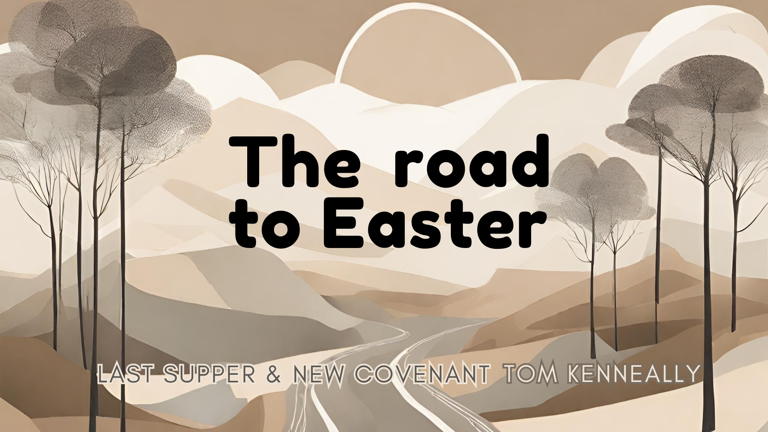

Slide 2
The story so far..
There has been a promise made of redemption
  This promise includes using people to help it occur
Jesus has arrived in Jerusalem and has received praise, hope rests on His shoulders for many. Yet, many have not asked how He will secure their hope.

Slide 3
The Old Covenant
There are a few old covenants –
  Noah – never flood again (A Royal Grant)
  Abraham – Great nation, Promised Land, Blessings to all people
  MOSAIC – Become my people, obey my ways for you

Slide 4
The role of sacrifice in Mosaic covenant
A reminder that there is a cost to sin
Death is and always has been the price

Slide 5
Inadequacy of the Old Covenant
Temporary
For if that first covenant had been faultless, there would have been no occasion to look for a second" Hebrews 8:7
Human Frailty

Slide 6
Jesus
Fulfilment of the old testament
  He is the lamb without the blemish
  He died as promised in Abrahams covenant
  He makes a way not to destroy
Perfect sacrifice – Has perfect values

Slide 7
Superiority of Jesus’ sacrifice
Eternal
Doesn’t require a trip into temple once a year, happened once and then done forever

Slide 8
Giving the New Covenant - Communion
The Passover meal – Turning this symbolic mean to point to christ
Broken bread, Grape juice – Broken Body, spilt blood

Slide 9
What it means for us?
Forgiveness of Sins – Hebrews 10:17-18
Personal relationship with God – John 14:6
Eternal life – John 3:16

Slide 10
What should we do?
Communion with God
Follow Jesus’ example
Spreading the Good news

